Slide 1
SAFE HAVEN THERAPY
JAMIE L. PICUS, PSYD
THOMAS M. BRUNNER, PHD

Slide 2
Table of Contents
Rationale & Context
Core idea & Child “Therapeutic Due Process”
Relevant Legal & Statutory references
Conceptual status: Debate & Divisiveness
Key psychological elements of Court Orders
Future Considerations

Slide 3
Rationale & Context

Slide 4
Linguistic History of concept
Often used with…
Finite weather phenomenon
Beer labels and Retirement plans

Slide 5
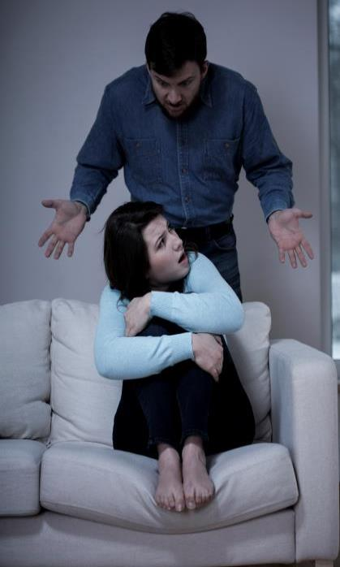
But the “weather” we are protecting the child from most often is not a temporary storm

Slide 6
Best image?
Need
consistently
THICK
walls
of
containment

Slide 7
UNHEALTHY, HARMFUL PARENTING
Undermining therapeutic recommendations
Refusal to follow recommendations
Not letting child speak for self or dictate how the child uses therapy
Play on child’s feelings, guilt
Ridicule or shame child for meeting his/her needs
Threaten child with loss of love (can be in passive-aggressive forms)
Create conflict with child after talking in therapy and then lay blame on child, other parent or clinician for affecting the child’s emotional state
Openly violate court orders
Make false accusations of physical, sexual or emotional abuse toward other parent
Not letting child speak in therapy
Verbal, emotional or physical abuse against the other parent or clinician in front of the child in the therapy setting
Reject the other parent or clinician in front of the child in therapy setting
Encourage child to reject or disrespect other parent or clinician
Refuse or lack follow through in therapy or with supports when deemed necessary
Encourage child to feign or threaten physical or emotional illness (e.g., threaten suicide)

Slide 8
WHY SAFE HAVEN THERAPY? HEALING HOSTILITY, REVENGE & DESTRUCTIVE PARENTING
“HOSTILE AGGRESSIVE PARENTING”
and a CHILD’S THERAPY
Pattern of a parent’s behaviors, actions and decision making that directly or indirectly:
Creates difficulties between a child and his/her ability to utilize therapy
Functions with the goal of damaging a child’s relationship with a therapist, which ultimately hinders the ability to utilize the therapy.
THIS IS A SERIOUS FORM OF DAMAGE, MALTREATMENT AND ABUSE TO CHILDREN

Slide 9
Healing Hostility, Revenge & Aggressive Parenting
IMPORTANT FACTS
1) When parents allow their own unresolved grief and parent conflict to become or remain excessive, then the harmful and destructive impact on the children will grow in correspondence.
2) The inability for a parent to contain or manage his/her grief is a serious sign of psychological immaturity, an inability to regulate emotions, and/or a severe inability to empathize with his/her child—ultimately meeting parent (unhealthy needs) at the child’s expense.
3) Parent empathy is critical for healthy child development.
True empathy is free of a parent’s projected issues.

Slide 10
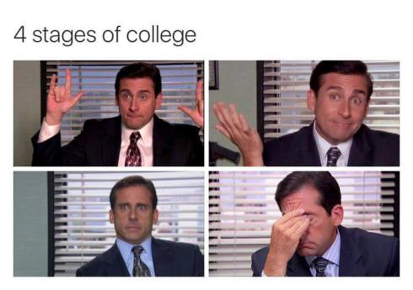
How each Parent Views Therapist
Degree of rapport widely varies
Rarely do both parents fully support throughout
See them as a “rival” or “threat”
Constant scrutinizing
Major differences b/t forensic therapy and traditional therapy (See handout)

Slide 11
Core Idea & Child “Therapeutic Due Process”

Slide 12
No matter who is doing it….
Psychologist, social worker, counselor, etc.
Safe Haven/Safe Harbor counselor
Court Interventionist
Court Appointed therapist

Slide 13
What is child therapeutic Due Process?
Will not exploit vulnerability
Will not violate trust
Will not break promise of confidentiality
Be loyal
Leads to disclosing trauma, secrets,
Facilitates corrective cognitive/emotional experiences

Slide 14
Therapeutic due Process = Protection of the Therapeutic Alliance
Relationship b/t patient and therapist
Level of trust
How feel about therapist
There must be skillful development of:
true understanding
genuine interest
common goals
provides comfort & keep secrets
Bottom Line to Irvin Yalom: Relationship of trust

Slide 15
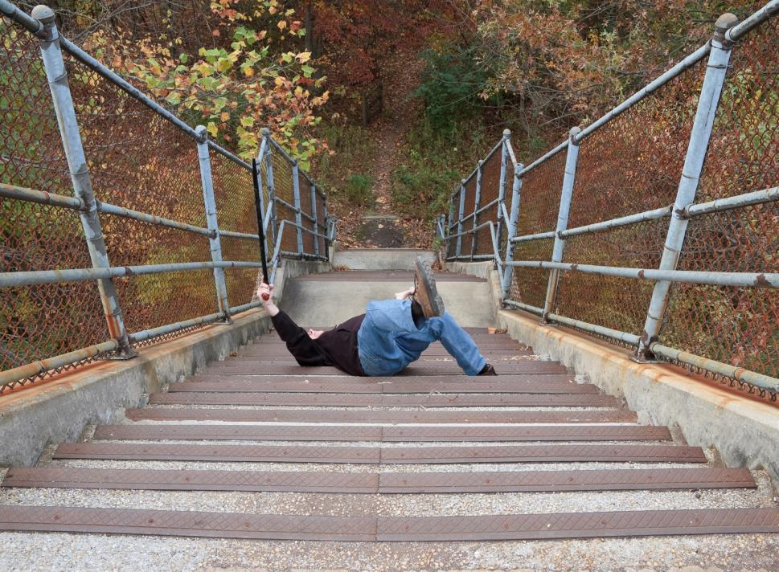

Slide 16
Why is a Safe Haven SO important?
Single greatest indicator of which children
will be resilient in face of
challenging situations:
Presence of a Mentor

Slide 17
Purposes of a safe haven
Improve mental health of child
Rehabilitate family relationships
Provide psychoeducation (PTSD)
Facilitate better exchange dynamics
Reporting maltreatment
Facilitate conflict resolution

Slide 18
What kind of access will lead to a “leaky” therapy alliance?

Slide 19
Debate
&
Divisiveness

Slide 20
Core (i.e., widely accepted) idea
Have a MH professional who cannot be compelled to testify at court about what the child has said in the counseling sessions, and records of sessions cannot be subpoenaed by parents.
Reasoning: Child should have a safe place to talk about his or her concerns and problems without worrying that everything he/she says will end up in court. It preserves doctor-patient privilege for the child.

Slide 21
Differing interpretations of Safe Haven…
In terms of what we are protecting…..
Content Records
Therapy session conversations with child
Conversations with parents
Therapist from having to testify/deposition

Slide 22
Ultimate Goal: Prevent Child from joining the epidemic population of psychologically impaired divorce survivors

Slide 23
Relevant
Legal &
Statutory References

Slide 24
US Supreme Court
United States Supreme Court Cases
Jaffee v. Redmond is a landmark case holding that “a privilege protecting confidential communications between a psychotherapist and her patient promotes sufficiently important interests to outweigh the need for probative evidence,” and thereby recognizing the psychotherapist-patient privilege under Rule 501, Federal Rules of Evidence. 518 U.S. 1, 9-10 (1996).
The Supreme Court reasoned that “[e]ffective psychotherapy . . . depends upon an atmosphere of confidence and trust in which the patient is willing to make a frank and complete disclosure of facts, emotions, memories, and fears.” Id. at 10.

Slide 25
Around the U.S.
At least 8 states have specific statutes regarding permissibility of non-disclosure of a child’s mental health records to a parent if non-disclosure is found to be in the child’s best interests: Arizona, California, Illinois, Minnesota, North Dakota, Texas, Virginia, and Washington.
At least 10 other states allow non-disclosure of a child’s mental health records based on applicable privilege statutes

Slide 26
AZ ARS 12-2293: Stipulations for Non-release of medical records by a health care provider
Core of Statutory Basis
So….a therapist may decide the patient (the child) could be harmed by revealing what the child has told the therapist. Specifically, if the therapist states that revealing information to the “patient’s health care decision maker” (i.e., the parent) is “reasonably likely to cause substantial harm to the patient (or another person)”,
Could also apply to processes like testimony or Subpoenas.

Slide 27
Unpublished AZ decision on Safe Haven issue
Harepoo v. Dahnad, Division 1 of the AZ Court of Appeals
Agreed w/ trial court that children’s therapy records would not be released to Father, based on therapist’s opinion that release of the records would not be in the children’s best interests.
Memorandum decision references ARS 25-408K (the presumption of a parent’s entitlement to the child’s records) and its exception if such disclosure would “endanger seriously the child’s or a parent’s physical, mental, moral or emotional health.”
Trial court’s finding that the records would not be released was upheld. This decision does not mention ARS 12-2293B.
Harepoo case cannot be cited as precedent in Arizona, unless it qualifies under Supreme Court Rule 111(c), as it is not a published opinion.

Slide 28
What if abuse/neglect involving child is alleged?
ARS 13-3620 is Arizona’s duty to report statute
Subsection G provides that release of a child’s records does not violate privilege in the case of investigation of child abuse or neglect proceedings.
So even if abuse or neglect is alleged and is the subject of police or agency investigations, no one can assert privilege to prevent the production of therapy records.

Slide 29
Conceptual status: Debate & Divisiveness

Slide 30
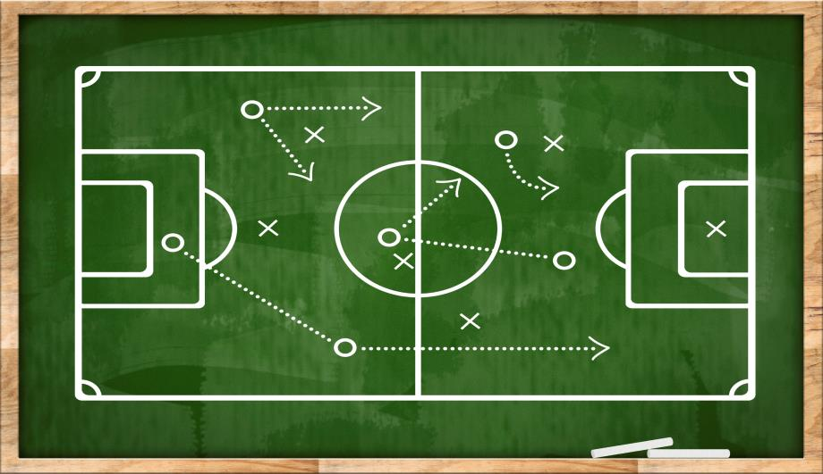
Differentiable Goals creating tension

Slide 31
Problem 1: “I’m out!!!”
What do clinician’s do
when pulled into court
or have to testify?
Answer: Termination b/c promise of confidentiality is gone

Slide 32
Problem 2: Frontloaded Safe Haven agreements
Technically, a therapist must state that access is reasonably likely to cause harm, it stands to reason that the therapy must have already started.
Therapist not in position to state that records will cause harm if the records don’t exist yet.
Safe haven agreements that are signed by the parents before the child’s therapy starts, are unreliable and arguably don’t meet the statutory standard.
Recognize therapist needs to make a finding, after therapy has started, as to whether or not access to records are likely to cause harm.

Slide 33
Problem 3: Meaningfulness of evidentiary distinction to child
Attorneys: safe haven should NOT protect communications b/t therapist and parent.
Retort: Stmt’s to parents often deeply intertwined with what child has said to them > pulled into citing child’s comments to defend rationale.
Then who looks like they are hiding something? Therapist!

Slide 35
What is the EVIDENCE that making therapist testify about communication with parents is any less NEGATIVELY impactful to the therapy due process than if therapist made to testify about what child said?

Slide 36
AZ 12-2293 – References a record, not what is being discussed or who are the discussants
12-2293. Release of medical records and payment records to patients and health care decision makers; definition
A. Except as provided in subsections B and C of this section, on the written request of a patient or the patient's health care decision maker for access to or copies of the patient's medical records and payment records, the health care provider in possession of the record shall provide access to or copies of the records to the patient or the patient's health care decision maker.
B. A health care provider may deny a request for access to or copies of medical records or payment records if a health professional determines that either…….

Slide 37
AZ 12-2293 (cont’d)
1. Access by the patient is reasonably likely to endanger the life or physical safety of the patient or another person.
2. The records make reference to a person other than a health professional and access by the patient or the patient's health care decision maker is reasonably likely to cause substantial harm to that other person.
3. Access by the patient's health care decision maker is reasonably likely to cause substantial harm to the patient or another person.
4. Access by the patient or the patient's health care decision maker would reveal information obtained under a promise of confidentiality with someone other than a health professional and access would be reasonably likely to reveal the source of the information.

Slide 38
Key Psychological elements of Court Orders

Slide 39
Handout: Mental health professional based perspective on what safe haven aspects are important, and which have psycholegal implications
Blended in with a more generic form from other legal sources related to the matter
Could sounds legalistic, but focused therapeutic value of this document
If there is legal language, we wove psychological ideas into legal language
Some references were from real world sources
From various sources attorney and psychological sources

Slide 40
(6) Equalization of participation.
Use a standard pre-meeting form
Allows commensurate input
Minimizes surprise complaints
Weakens the non-participatory hijacker

Slide 41
(12) Informal complaints or concerns about counselor
Before elevating to formal complaint, the parent must show a persistent track record of seeking to resolve their concern through a collaborative, ongoing, professional communication and problem solving process with therapist.

Slide 42
Criteria for SH success
Strong, front loading court order (See Handout)
Goes beyond generic recommendations
Language to contain specific toxic parent behaviors
Minimize parent claiming marginalization (See Handout)
MOST IMPORTANT: Retain a bird’s eye view of probative claims

Slide 43
Future
Considerations

Slide 44
IS IT WORTH IT?
Sharing a child’s information can:
Damage current trust in therapist
Minimize or prevent ability to trust another therapist
Undermine years of therapeutic gain
Result in LOSS of the ONE neutral support that supports the child’s needs ASIDE FROM from the adult issues

Slide 45
Goes beyond generic recommendations
Cannot just say court ordered therapy
Remember image of nuclear reactor
Thick walls where necessary
Prep - disastrous meltdowns
Contain toxicity

Slide 46
TRUE GOAL
-Since very fragile…
…not merely stabilize but bring some healing and increase resilience

Slide 47
Reasons safe haven fails include….
Much less defined
Most vulnerable
May be artificially time-limited
Therapist coerced/manipulated/complaints
Psycholegal focus = hollow improvements

Slide 48
Bird’s eye view of Probative claims
As a Wise person once said:
Keep things in proportion

Slide 49
Key questions to ask if requesting therapist involvement…
How much will the evidence seeking matter in 5 years?
Is this evidence present elsewhere?
Is this evidence likely to manifest elsewhere?
Is a Summary of Treatment letter acceptable?
Is there another way to get this information?
Notes:
Summary of treatment letters can be tweaked

Slide 50
Serious potential problems with requesting various kinds of information

Slide 51
Growth on the surface, in times of storminess, requires deep rooted trust in a Mentor

Slide 52
Current tensions create diversity of choices case by case

